Slide 1
Covid Mini Project 2
Jonathan Snedeker

Slide 2
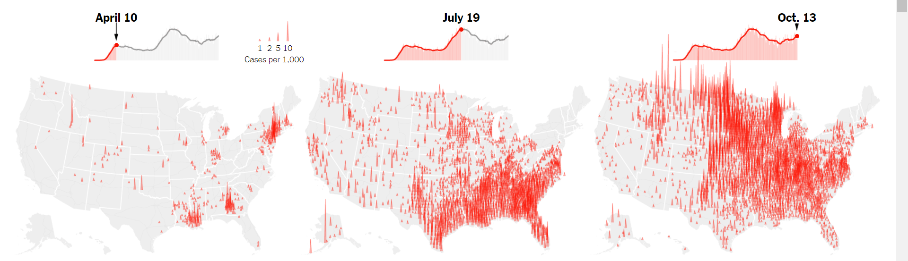
Big Q: Are We Approaching Pseudo-Herd Immunity
https://www.nytimes.com/interactive/2020/10/15/us/coronavirus-cases-us-surge.html

Slide 3
Big Q: Are We Approaching Pseudo-Herd Immunity
For the most part, each region has seen at maximum one outbreak.
-Is this because people have changed behavior after a first major local surge?
-Is this because enough people have been infected in local areas that there is a pseudo-herd immunity
Final Project: Can we locally estimate the fraction of people effected and whether there is local herd immunity
https://www.nytimes.com/interactive/2020/10/15/us/coronavirus-cases-us-surge.html

Slide 4
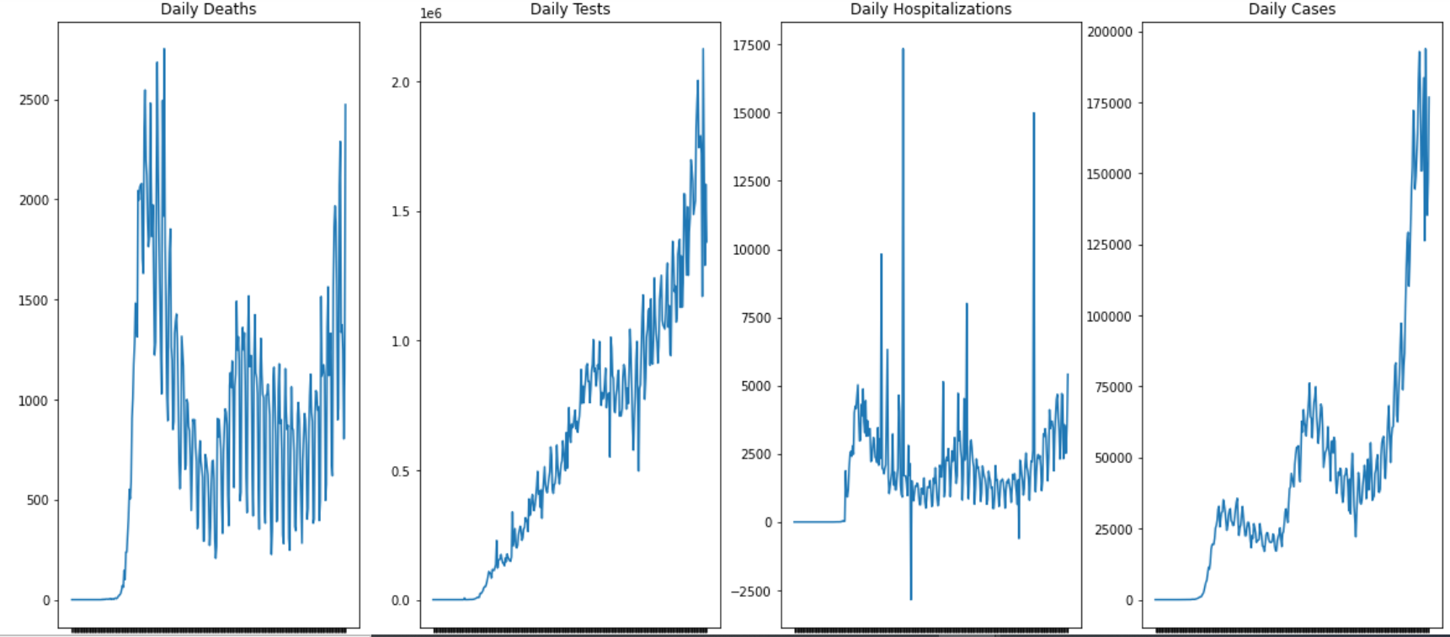
Replotting Basic Metrics
Data from Covid Tracking Project

Slide 5
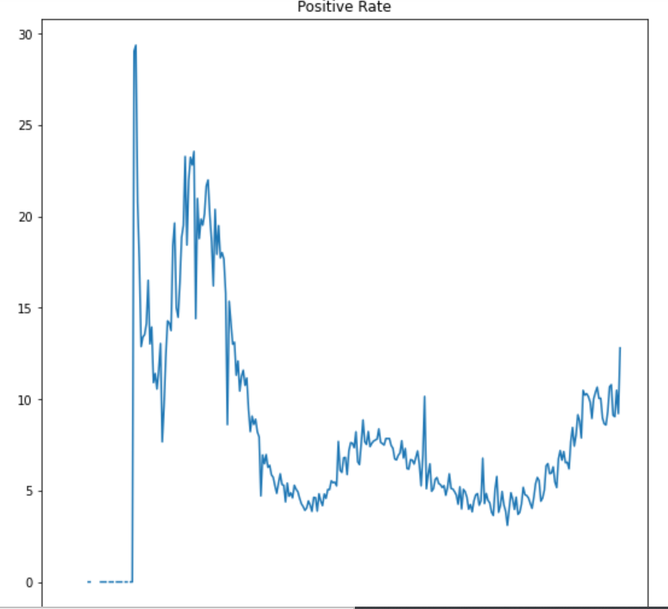
Positive Rates are a Function of Actual Cases and Testing

Slide 6
Theory for Approaching Bigger Question
People can be grouped into three simplified camps. Had virus and positive result, had virus without positive result, or never had virus. To estimate total infections I will need to estimate how many people had the virus without testing positive.
Estimates of actual total infections are available for certain places at certain times with antibody testing studies. This can be used to get a baseline estimate of what positive rates and reported caseloads correspond to actual population infection rates.
Local as well as national data is available on Covid Tracking Project.
Once baseline estimates are established, I can estimate the fraction of the population that have been infected in every area.

